Slide 1
Data Structures and Algorithm
COURSE CODE: CS-201
TOPIC: ARRAYS
COURSE INSTRUCTOR: HABIBA ARSHAD

Slide 2
Today’s Goal
Operations on Array

Slide 3
CLO Covered in this Lecture
CLO2: Apply and design various data structures methods for specified applications.

Slide 4
Operations on Linear Array
We can perform various operations on a linear array:
Traversing- processing each element of the array list.
Inserting- adding new elements in the array list.
Deleting- removing an element from the array list.
Sorting- arranging the elements of the list in some sorting order.
Merging- combining the elements of two array lists in a single array list.

Slide 5
Overflow & Underflow
Overflow: Attempt to insert an element into an array exceeding its size limit.
Underflow: Attempt to delete or traverse an element from an empty array.

Slide 6
Traversing Linear Arrays
Traversing is accessing and processing (visiting ) each element of the data structure exactly ones
Linear Array
•••

Slide 7
Traversing Linear Arrays
Traversing is accessing and processing (visiting ) each element of the data structure exactly ones
Linear Array
•••

Slide 8
Traversing Linear Arrays
Traversing is accessing and processing (visiting ) each element of the data structure exactly ones
Linear Array
•••

Slide 9
Traversing Linear Arrays
Traversing is accessing and processing (visiting ) each element of the data structure exactly ones
Linear Array
•••

Slide 10
Traversing Linear Arrays
Traversing is accessing and processing (visiting ) each element of the data structure exactly ones
Linear Array
•••

Slide 11
Traversing Linear Arrays
Traversing is accessing and processing (visiting ) each element of the data structure exactly ones
Linear Array
•••

Slide 12
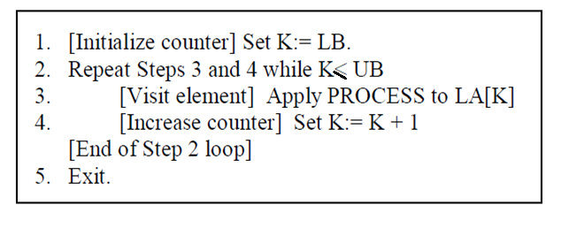
Traversing Algorithm
We can process each element of an array with the help of an index set.
Consider a Linear Array(LA) list given with lower bound(LB) and upper bound(UB) that contains 'n' number of elements. We can traverse the list with the given algorithm.

Slide 13
Searching in Linear Arrays
Search ‘4’ in the following linear array:
10 | 3 | 5 | 9 | 4 | 8 | 1 | 2

Slide 14
Types of Searching in Arrays
Linear Search
Binary Search (can only be applied on sorted array)

Slide 15
Linear / Sequential Search
Sequential search is also known as linear or serial search. It follows the following step to search a value in array.
  Visit the first element of array and compare its value with required value.
  If the value of array matches with the desired value, the search is complete.
  If the value of array does not match, move to next element and repeat same process up till to the length of array until the desired element is found.

Slide 16
Linear Search Algorithm
1. Start
2. Set i = 0
3. Repeat steps 4 & 5 while i < UB
4. IF (item==LA[i]) THEN GOTO Step 6
5. Set i = i + 1
6. Print ‘record found at index i’
7. Print ‘item not found’
8. Stop

Slide 17
Time Complexity
Running time for Linear Search is O(n) as it depends on input size.

Slide 18
Binary Search
Binary search is a quicker method of searching for value in the array. But binary search is applied only on sorted array.
It locates the middle element of array and compare with desired number.
If they are equal, search is successful and the index of middle element is returned.
If they are not equal, it reduces the search to half of the array.
If the search number is less than the middle element, it searches the first half of array.
Otherwise it searches the second half of the array. The process continues until the required number is found or loop completes without successful search.

Slide 19
Binary Search Algorithm
if UB== -1, then print ‘underflow’ & return.
Repeat while (LB<=UB)
{
mid=(LB+UB)/2;
if (LA[mid]==item)
print ‘item found’; return LA[mid];
elseif (item<LA[mid])
UB=mid-1;
else
LB=mid + 1;
}
print ‘item not in list’;

Slide 20
Time Complexity
Running time for Binary Search is O(log n) as it divides the array in two half if required element is not found

Slide 21

Questions?

